Slide 2
DF TICKETING SYSTEM Mobile Compatible https://dfticketing.org

Slide 3
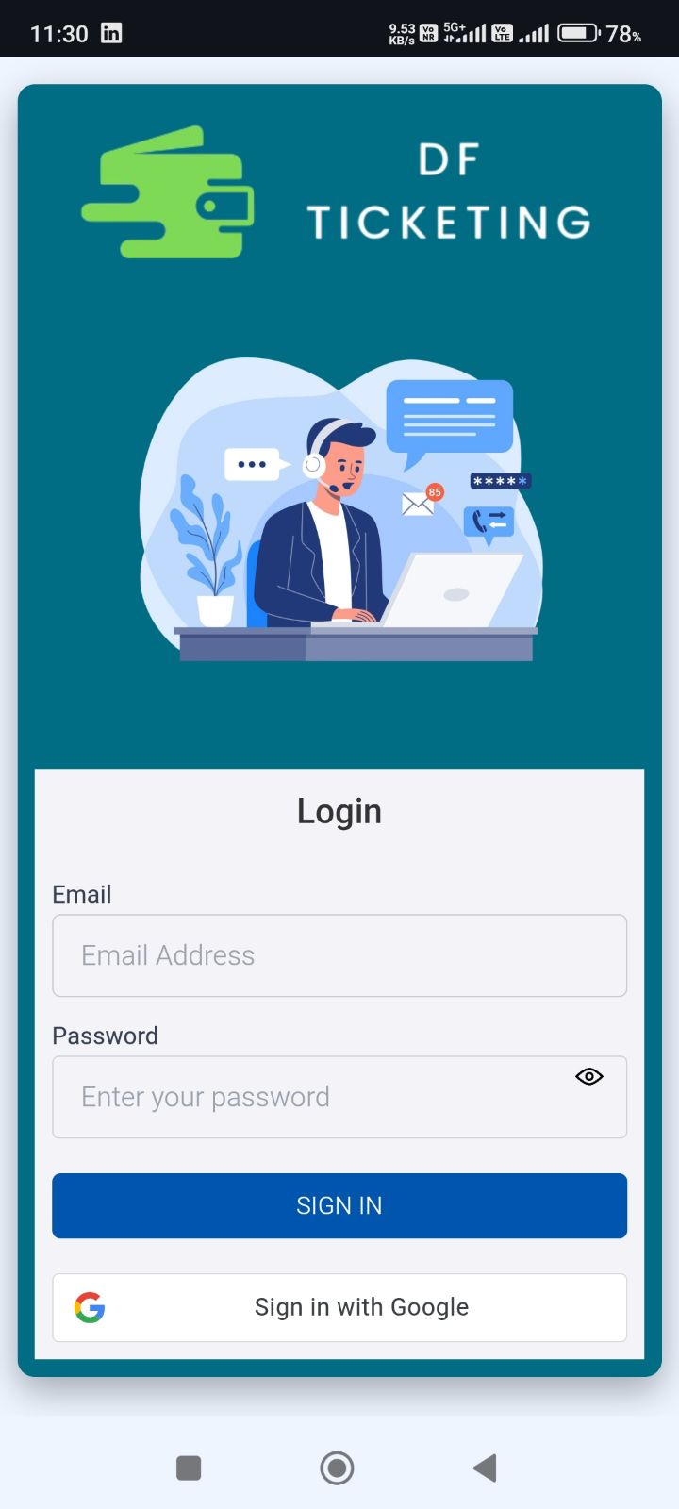
Login Page
You can log in using your DF email and the auto-generated password sent to your registered email address.
OR
You can log in using the Google option with your registered DF email address.

Slide 4
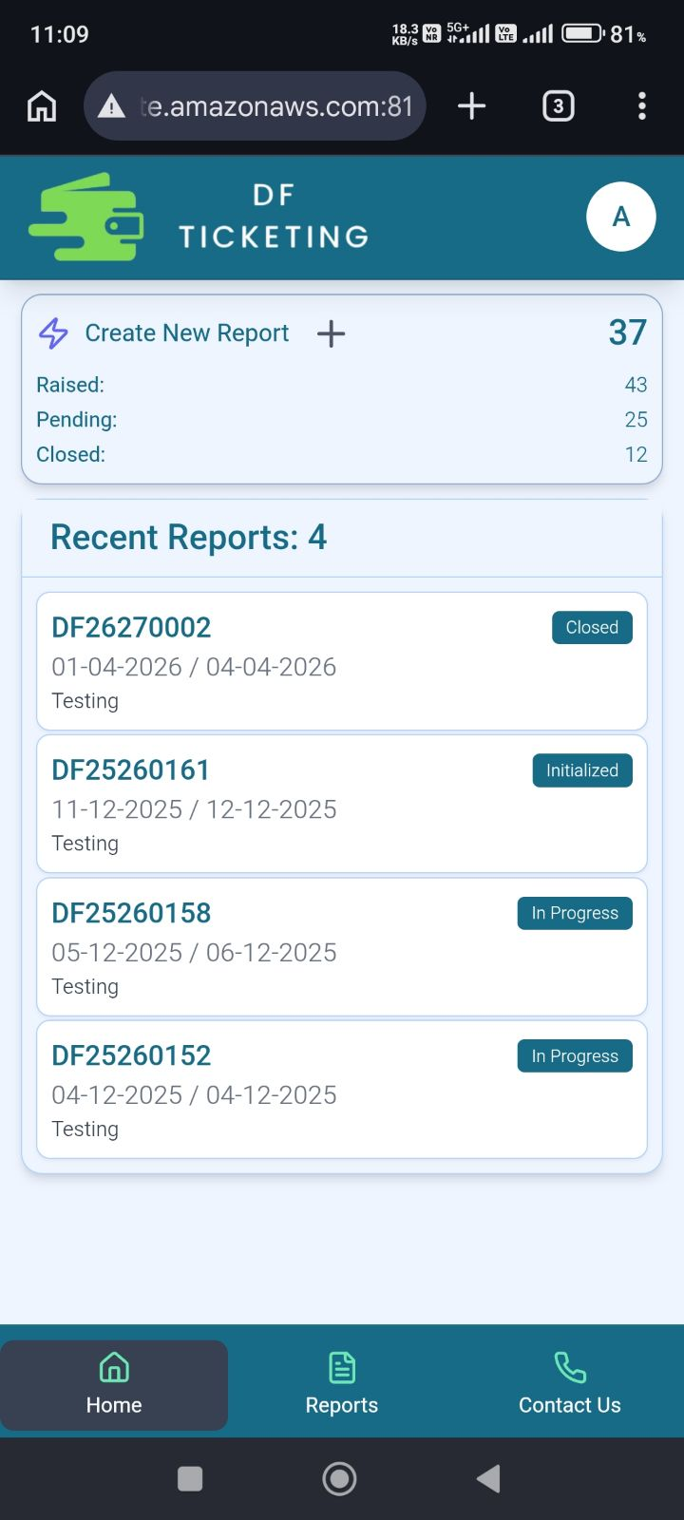
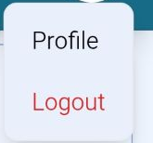
Home Page
This is the Profile section
Click the plus (+) button to create a new report.
In this section, you can view the Report Details, including the Report Number, Report Period, Process Status, and Report Description.
Home page
Reports page
Contact Us page

Slide 5
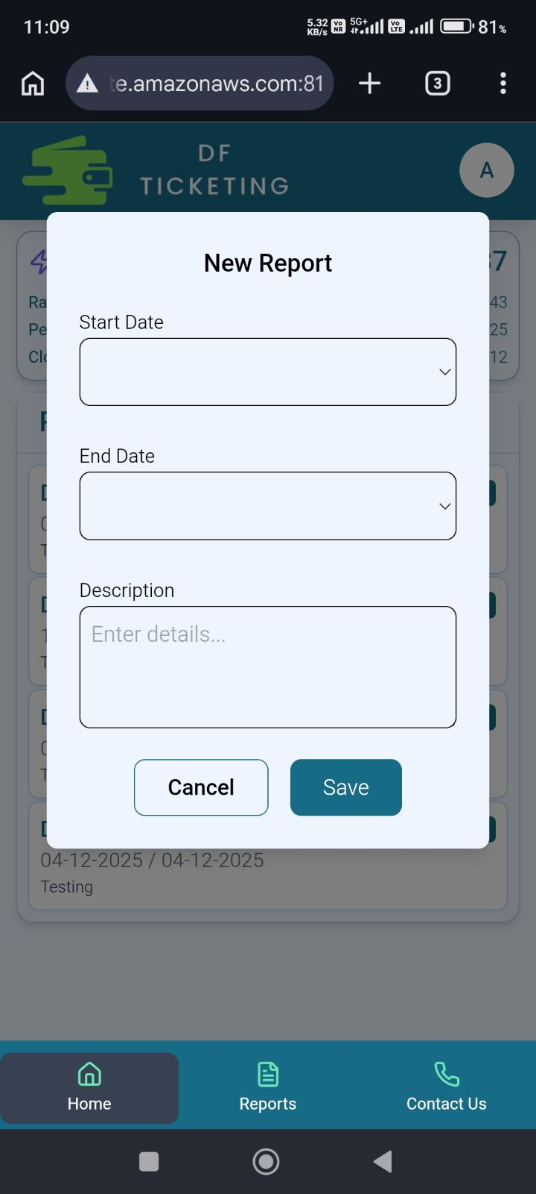
Create NEW Report
These dates define the time range for the tickets you intend to create.
When you click the plus (+) button, this pop-up will appear. You need to fill in all the details, including the Report Start Date, Report End Date, and a short description of the report.
Click on 'Save' to create the report.

Slide 6
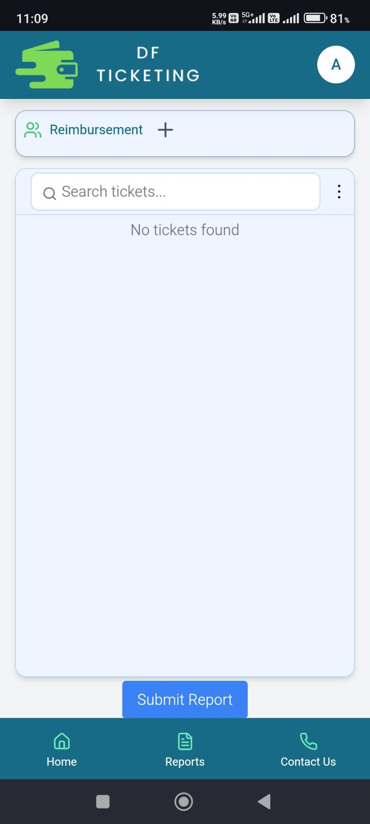
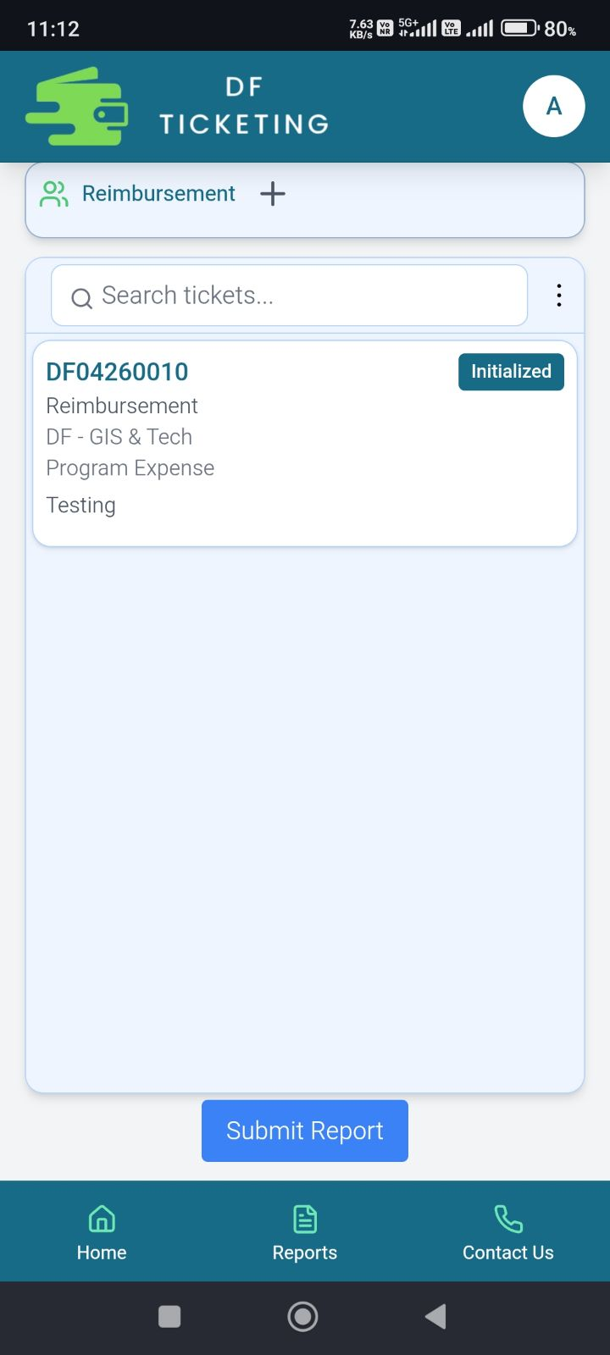
Tickets Section
Click on this to create the Reimbursement Ticket
Here, you can view the tickets you have created.
Click 'Submit' to submit your report along with all your tickets.

Slide 7
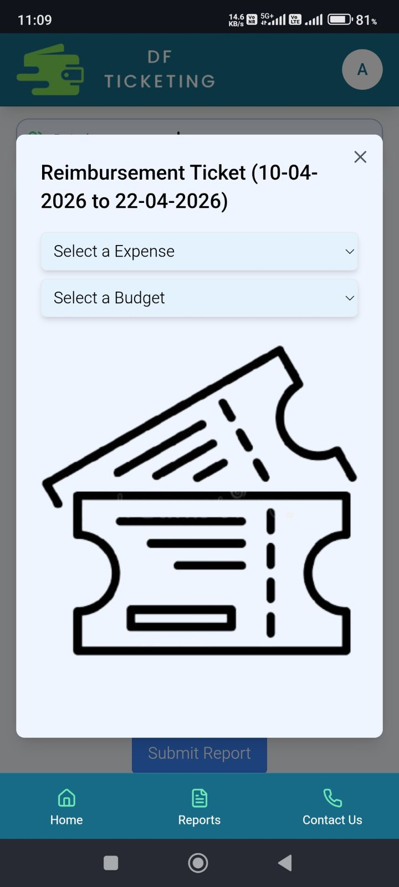
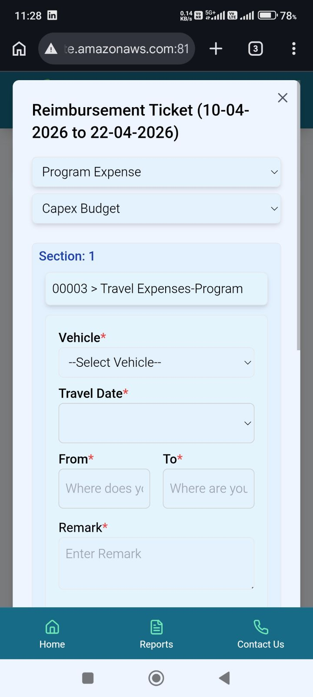
Create Reimbursement Ticket
When you click the plus (+) button next to Reimbursement, a pop-up will open where you need to select the Expense Type and Budget Type.
As you make your selection, the section below will open, allowing you to choose the reimbursement category—such as Food, Travel, Accommodation, etc.

Slide 8
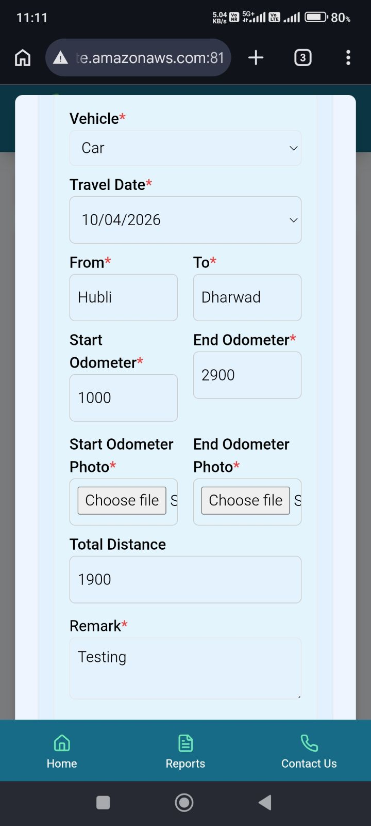
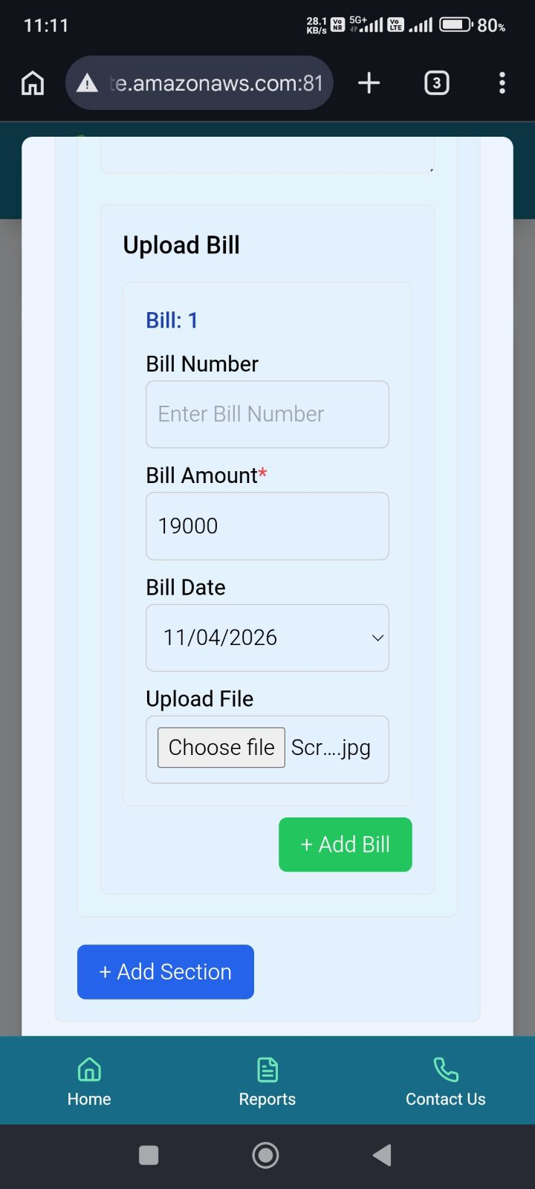
Reimbursement
Now, if you select Travel, this section will open where you need to fill in all the details marked with a red asterisk (*).
The section below is for attaching bills related to that expense.
When you click 'Add Bill,' a new bill section will open.
When you select 'Add Section,' a new section opens for you to add a new expense category.

Slide 9
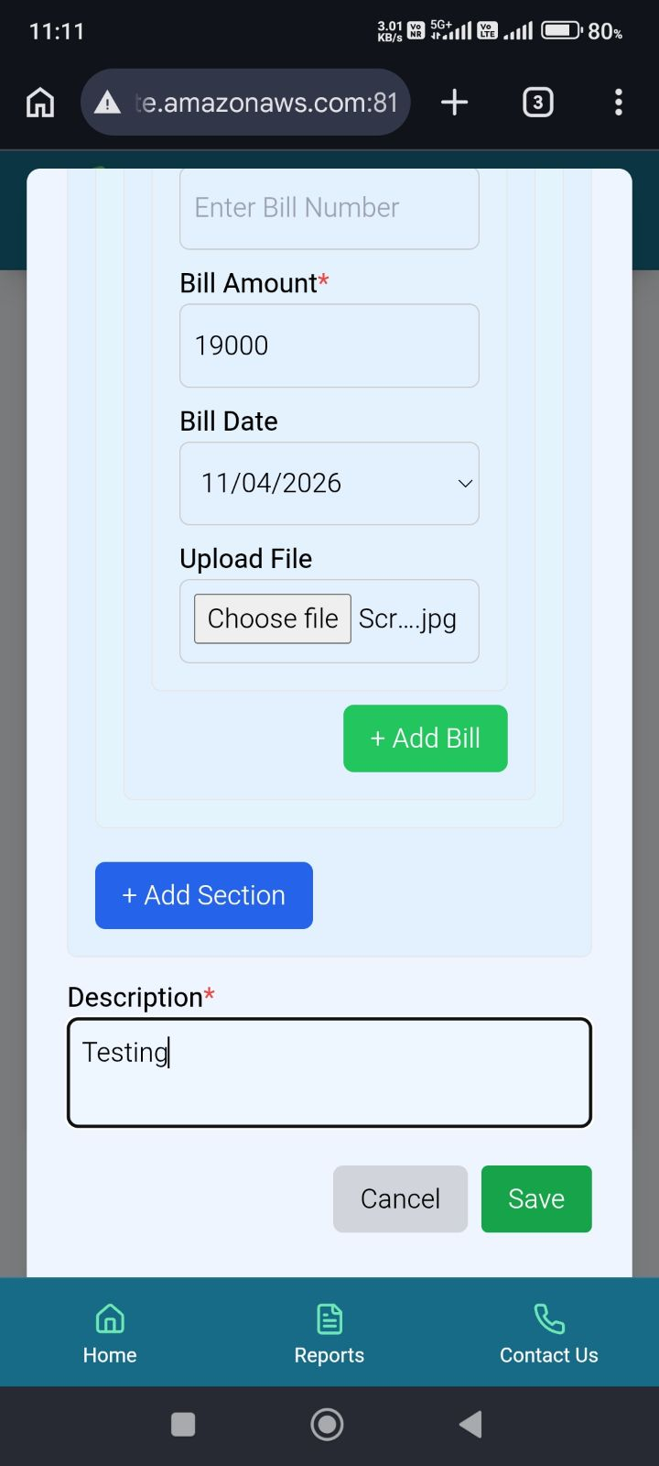
Create Ticket Additional Details
Click on the ticket to see the details that you have added
Here, you need to add a brief description.
Click the 'Save' button to create the ticket.

Slide 10
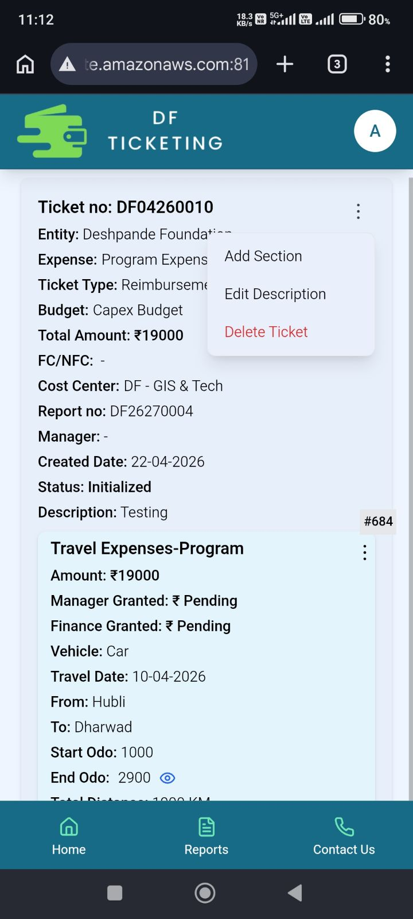
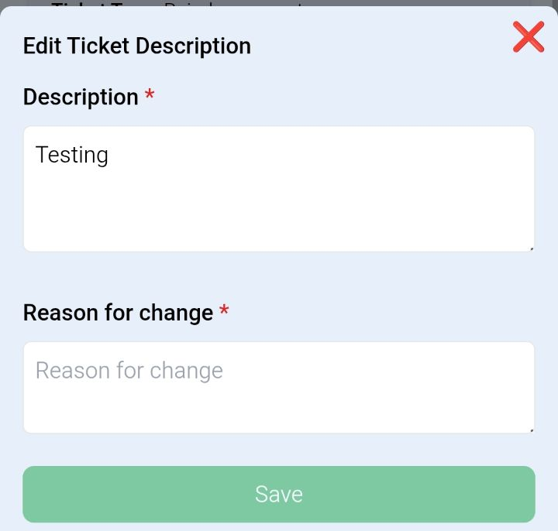
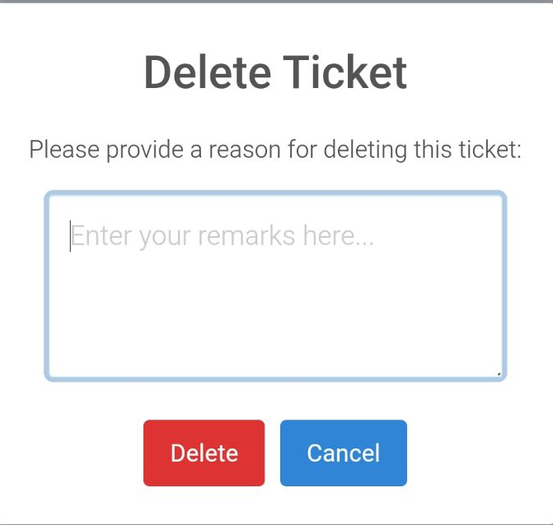
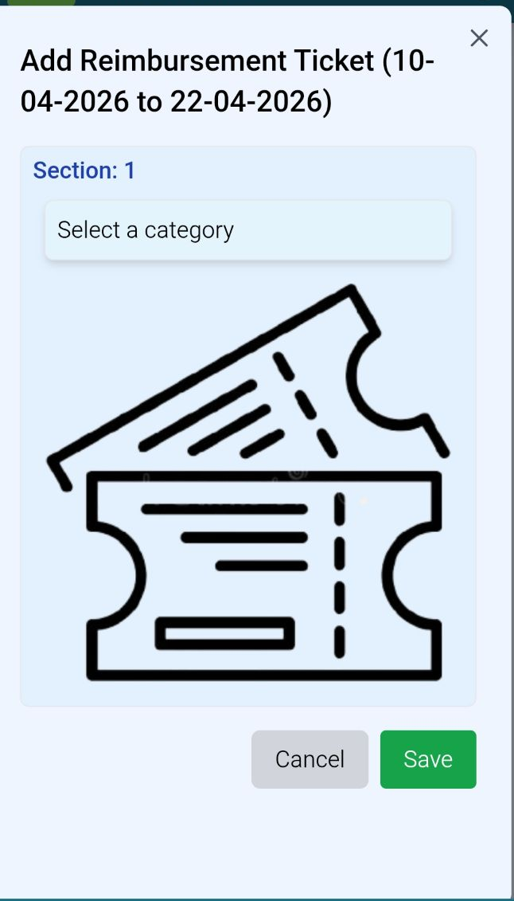
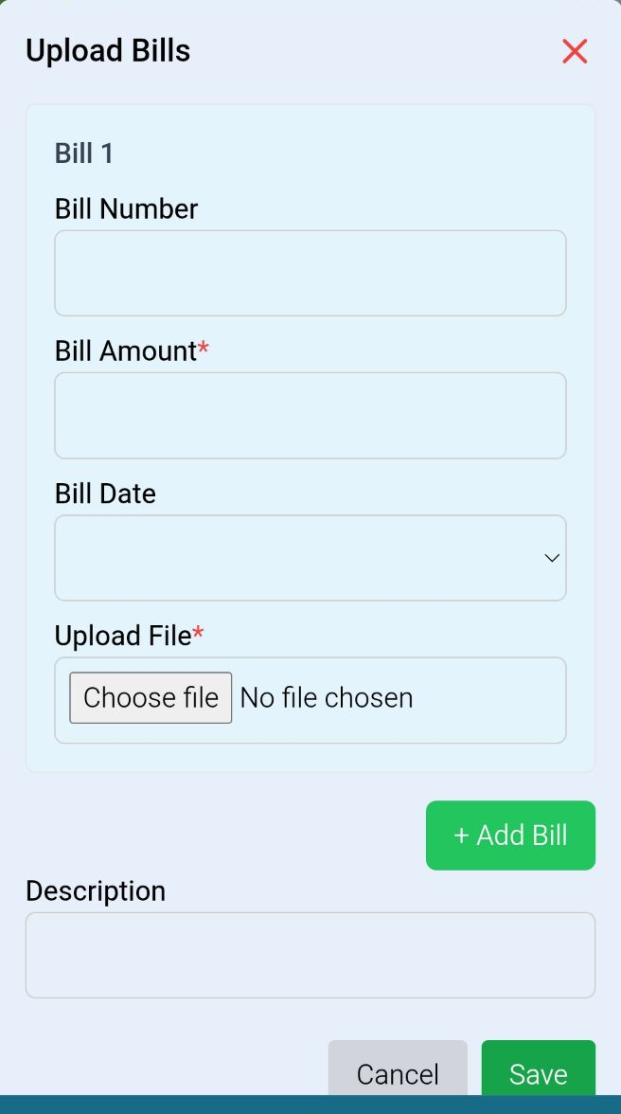
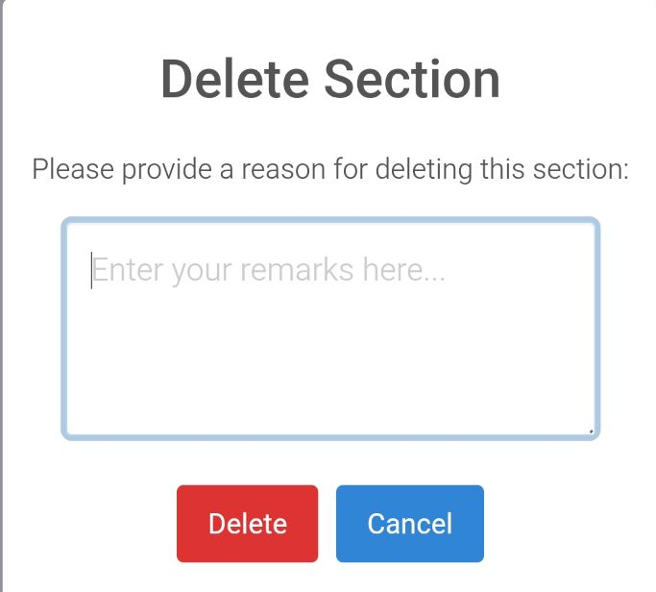
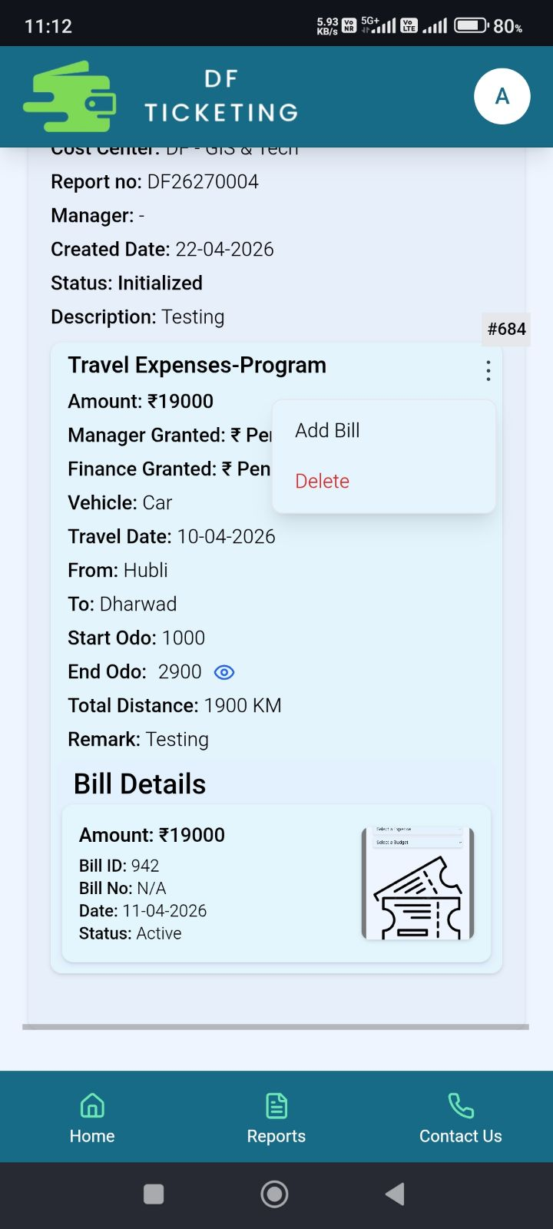
Inside Tickets (Initialized)
At the initial stage i.e., if you have not submitted the report, or if the manager or finance has rejected the ticket you can add a new section to the ticket or delete the entire ticket.
Edit Ticket Description
Delete Ticket
This is section ID
At the initial stage, you can add bills to a section, delete a bill from a section, and also delete the entire section.
Add Section
Delete Section
Add Bill

Slide 11
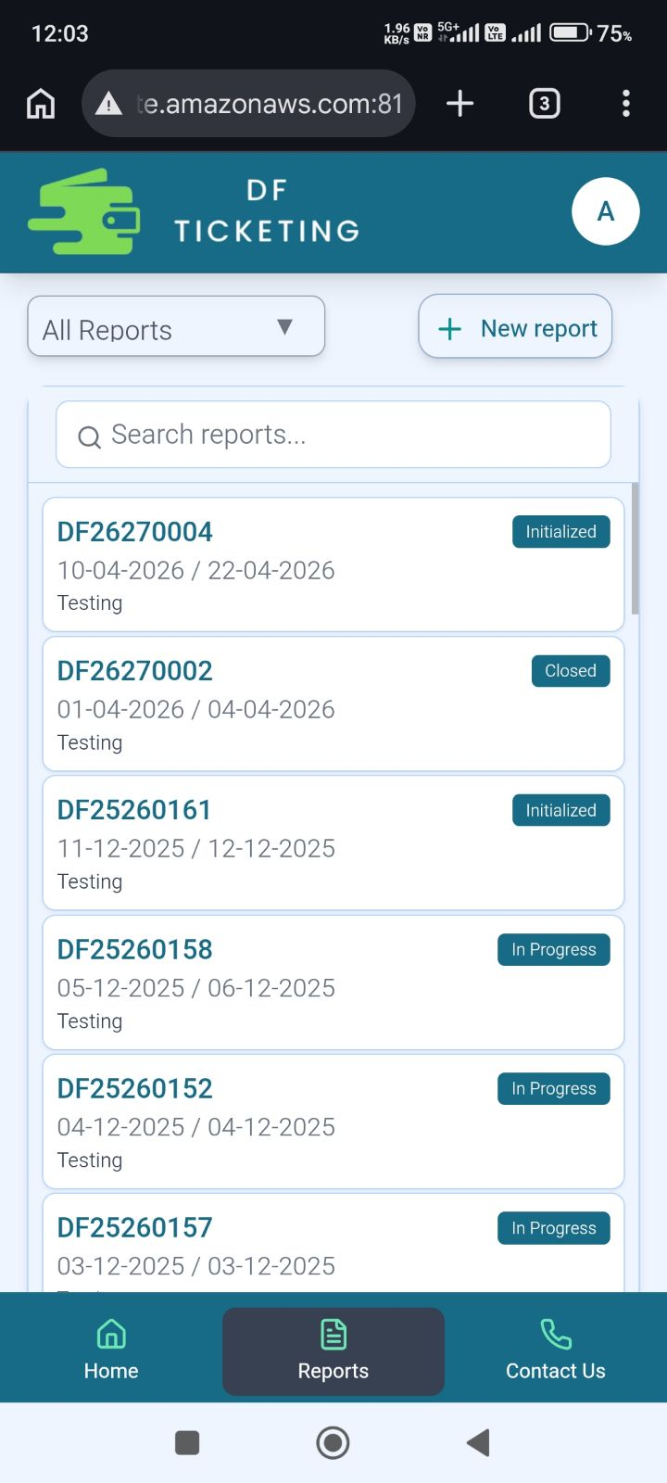
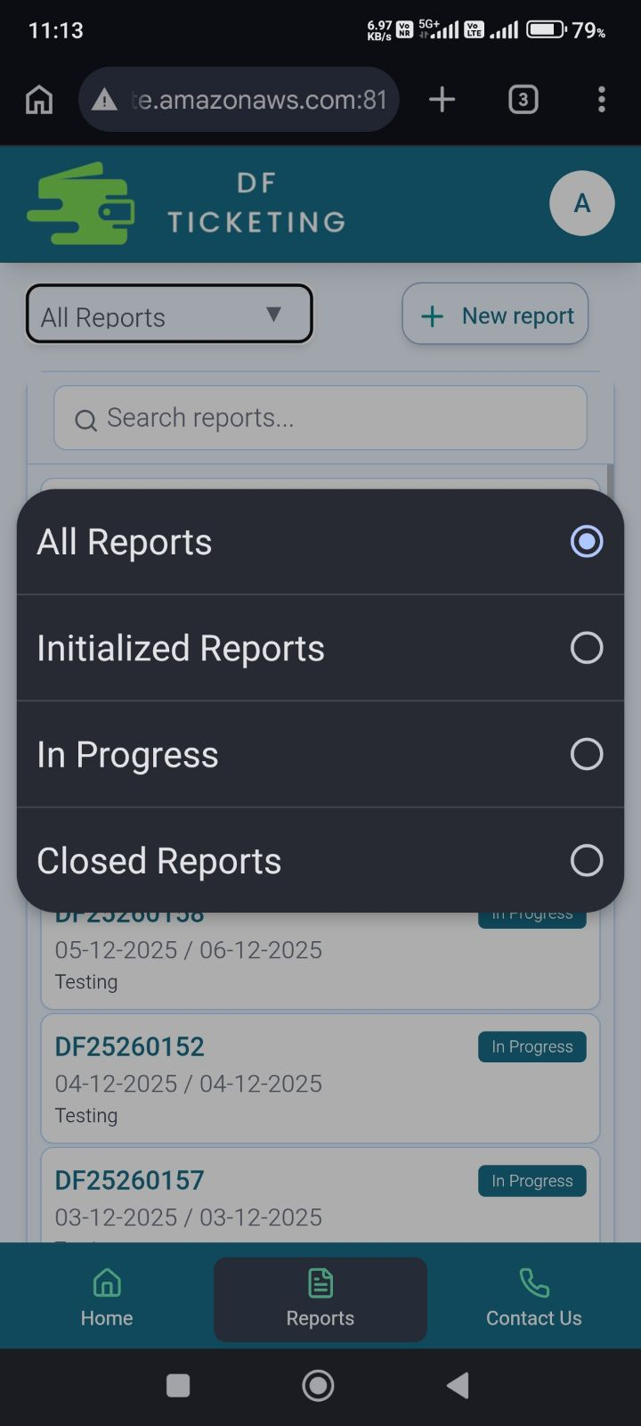
Reports Page
Here you can see all your reports till date.
Click on this to create report
From This dropdown you can select your reports according to their status

Slide 12
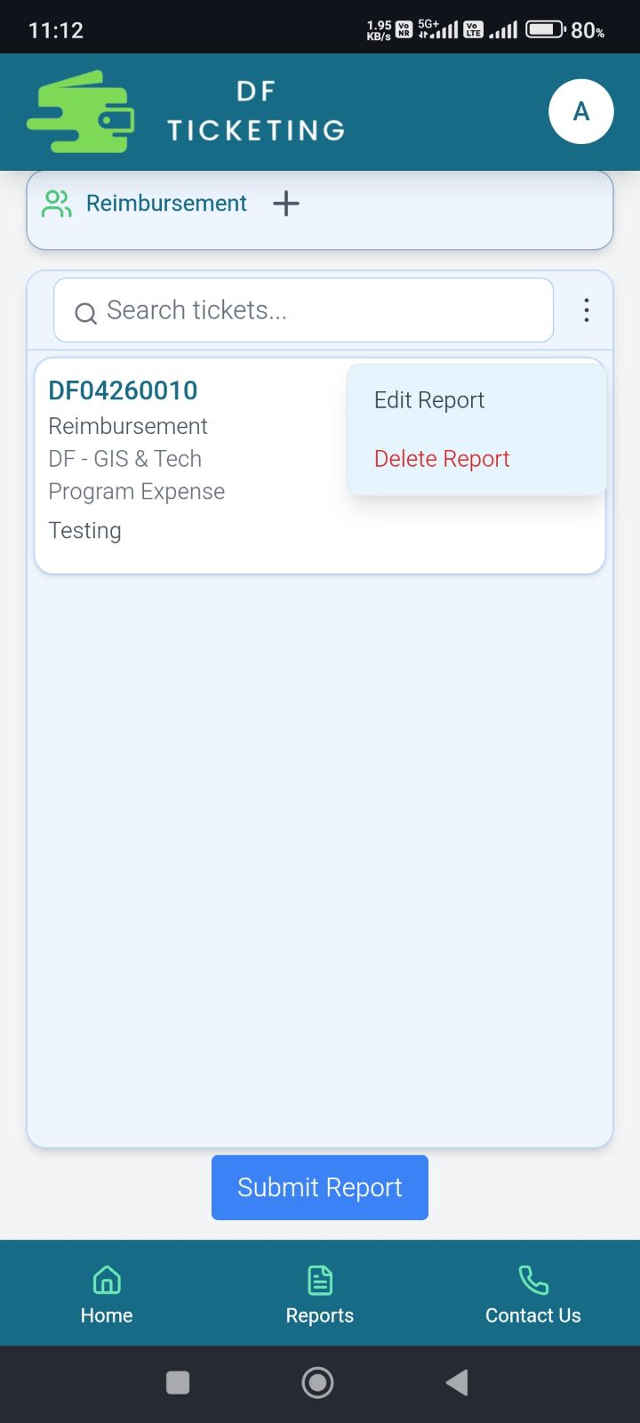
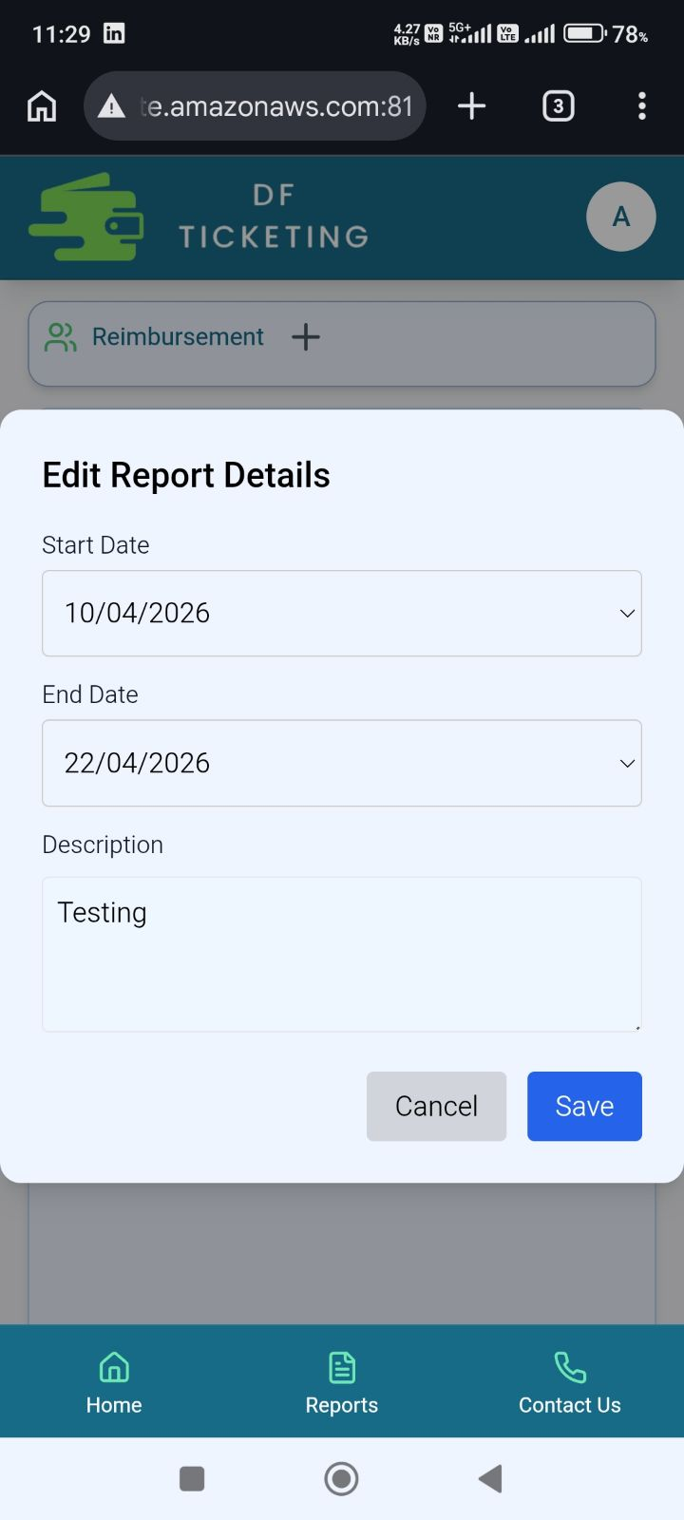
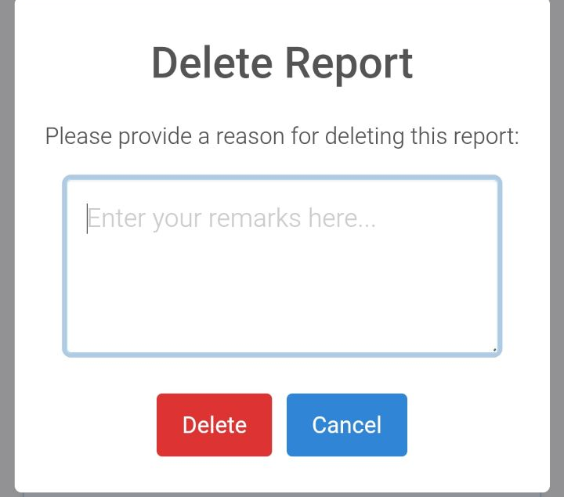
Report Edit
On edit this popup opens up
When a report is in the Initialized, Manager Rejected , FA Rejected stage then you can Edit the report.
On delete this popup opens up

Slide 13
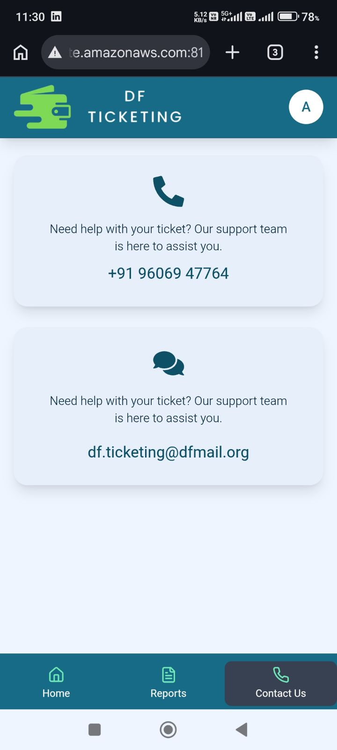
Contact Page

Slide 14
Thank You

